Slide 1


DATA & AI Datathon FY’25
Jasmin Mohamed, Isabella Madiedo, Veer Shah, Yesol Park, Cheryl Liu
Team 05

Slide 2
Contents
1
Introduction & Meet the Team
2
Challenge Brief
Studying the effect of diabetes in the human body
3
Data Cleaning report
4
Initial EDA report
5
Data Engineering
6
SQL Database Build
7
Data Visualisation
8
Summary & Conclusion

Slide 3





Meet the team
Jasmin Mohamed
Business Architecture Analyst
Snowflake and SQL Expert
Isabella Madiedo
Ind & Func AI Decision Science Analyst
Python Expert
Veer Shah
Ind & Func AI Decision Science Analyst
SQL & Viz Expert
Yesol Park
Business Architecture Analyst
Power BI Expert
Cheryl Liu
Business Architecture Analyst
Power BI Expert

Slide 4

Intro & Challenge Brief
Notes:
Diabetes Awareness Month
Analyzing diabetes data to inform prevention and treatment strategies.
Highlight the journey from raw to cleaned data as foundational to reliable insights.

Slide 5

Data Cleaning

Slide 6
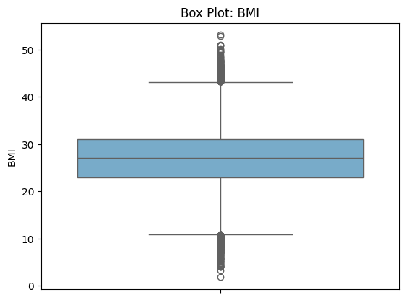
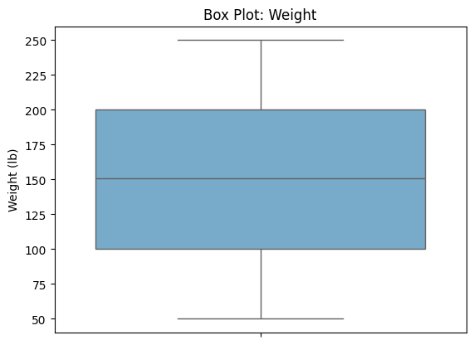
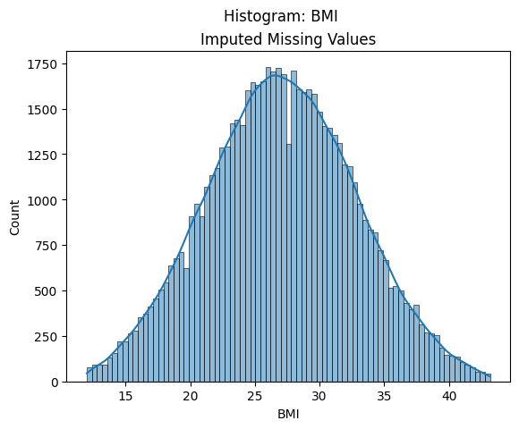
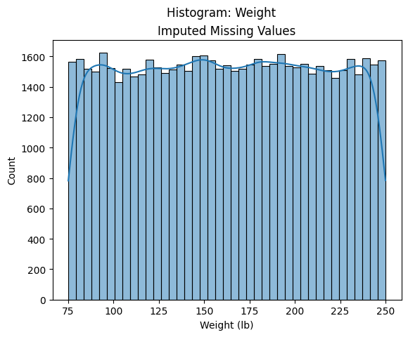
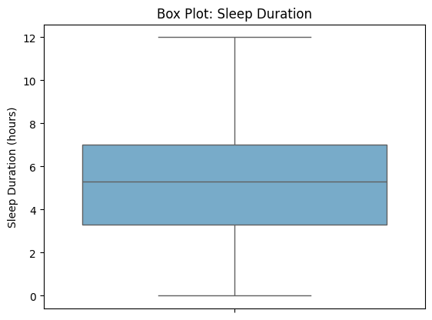
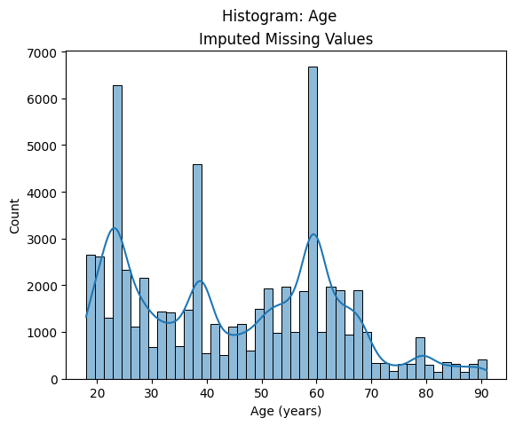
Data Cleaning Overview
Outliers & Inconsistencies Examples
Missing Values Examples
Notes:
Outliers & Inconsistencies examples
BMI: upper and lower-bound outliers > capped lower level at 12 (minimum BMI level before life threatening), capped lower lever using IQR (Q3 + 1.5 * IQR)
Weight: lower-bound outliers (unreasonable weight for a human adult) > dropped values below 75 lb
Sleep: the min hours of sleep registered was 0 (unreasonable) > data was capped at a min on 2 hours
Missing Values
Where appropriate and required missing values for explanatory variables were imputed using the corresponding distribution
Missing values for the target variable where not imputed or altered to avoid bias in the analysis

Slide 7

Exploratory Data Analysis
Notes:
Key Visualizations:
Histogram: Distribution of glucose levels.
Heatmap: Initial correlations between factors like cholesterol and BMI.
Emphasize that this process builds trust in the data.

Slide 8
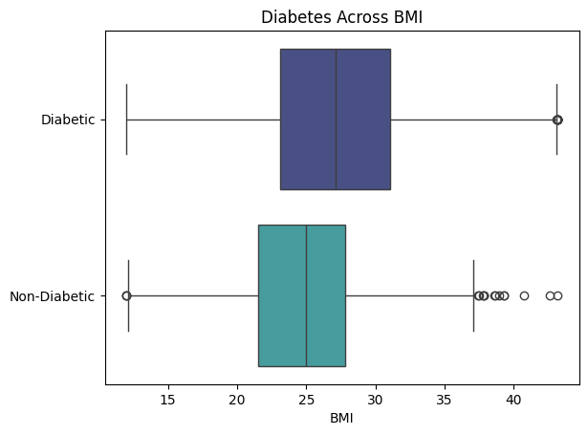
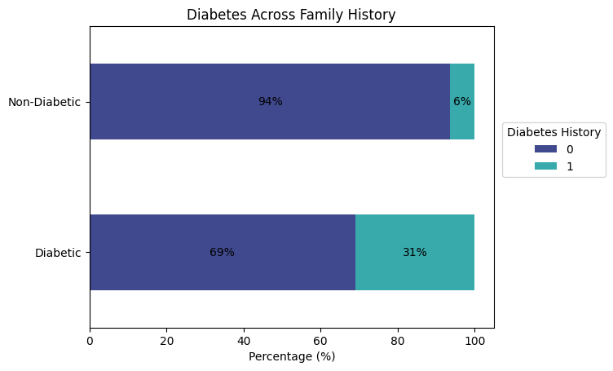
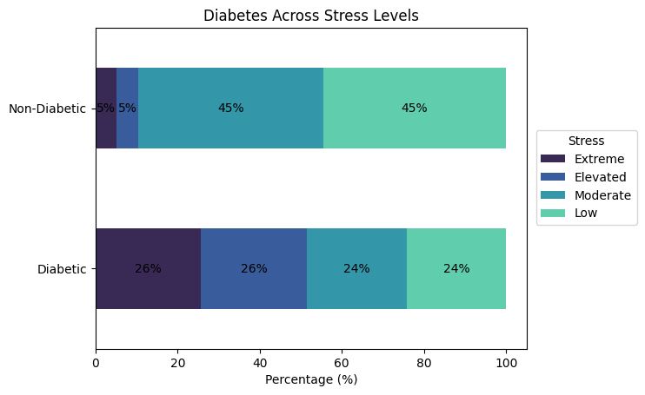
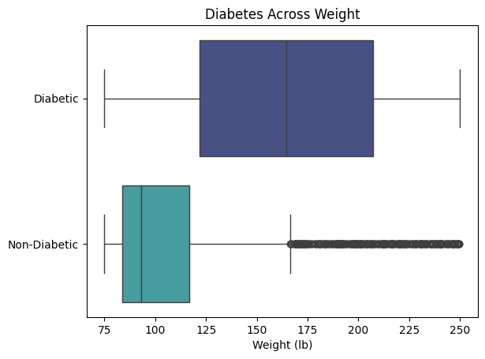
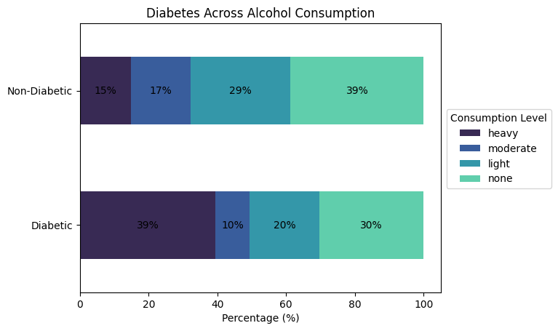
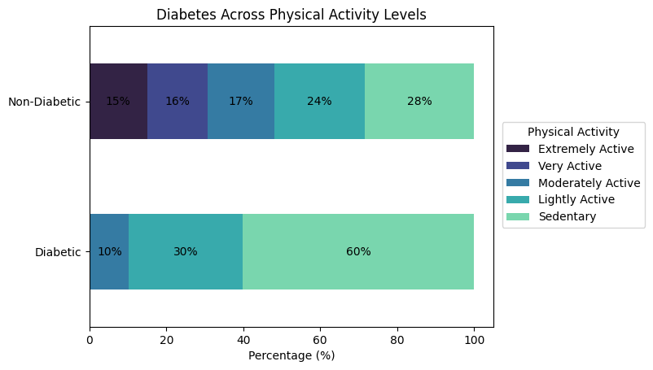
Exploratory Data Analysis (1/2)
Categorical Variables Examples
Numerical Variables Examples
Notes:
Categorical variables:
BMI: The preliminary visual analysis indicates that non-diabetic patients are more likely to have a lower BMI than diabetic patients. Nonetheless, it is worth highlighting that the non-diabetic patients have a wide range of BMI values with potential outliers in both the upper and lower bounds.
Weight: The preliminary visual analysis suggest diabetic patients tend to have higher weight records than non-diabetic patients. On this point it is important to highlight that weight is strongly related to BMI ($BMI = weight / height^2$), and in a similar manner to the behaviour shown on the boxplot for BMI, there are important outliers (specifically on the upper bound).
Numerical variables:
Family history: A preliminary visual analysis suggests there is a significant difference in diabetes diagnosis for patients with and without a family history of diabetes. This indication is reasonable given certain cases of diabetes can be caused by both genetic and environmental factors.
Stress level: The preliminary visual analysis suggests diabetic patients are more likely to experience extreme and elevated stress levels than non-diabetic patients. Though it is important to highlight that both stress can have an effect on health and health can have an effect on stress (e.g. following a diabetes diagnosis, experiencing diabetes symptoms).
Physical activity: The preliminary visual analysis suggests that diabetic patients are predominantly sedentary. While, non-diabetic patients have a wider range of physical activity, although the largest portion remains sedentary.
Alcohol: The preliminary visual analysis suggests diabetic patients are more likely to consume alcohol heavily. This relationship is worth studying further in the context of medicine, given alcohol can interfere with the effects of some diabetes medicines, while increasing the risk of Type 2 diabetes.

Slide 9
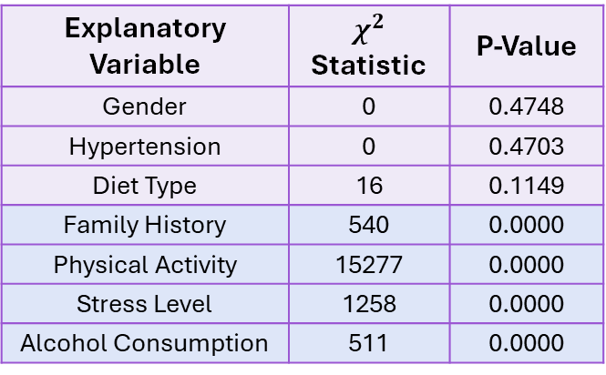
Exploratory Data Analysis (2/2)
Categorical Variables
Hypothesis Testing
Numerical Variables Hypothesis Testing
Explanatory Variable | $$χ^{2}$$ Statistic | P-Value
Gender | 0 | 0.4748
Hypertension | 0 | 0.4703
Diet Type | 16 | 0.1149
Family History | 540 | 0.0000
Physical Activity | 15277 | 0.0000
Stress Level | 1258 | 0.0000
Alcohol Consumption | 511 | 0.0000
Explanatory Variable | T-test Statistic | P-Value
Age | -1 | 0.2572
BMI | -19 | 0.0000
Weight | -45 | 0.0000
Sleep Duration | 0 | 0.6082
Pregnancies | -1 | 0.2430
Diabetes Pedigree Function | 0 | 0.5109
Notes:
Categorical Variables
The statistical analysis for the association of diabetes with each of the categorical variables in the dataset reveals, that with a 1% significance level, there exists enough evidence to reject the null hypothesis in the case of family history of diabetes, physical activity, stress level, and alcohol consumption. This conclusion supports the initial evidence gathered in the visual bivariate analysis. In addition, it is a reasonable indication in the context of diabetes:
- Family history: Type 2 diabetes can be caused by genetic factors
- Physical activity: regular excercise can result in sustained improvements in insulin sensitivity and glucose disposal
- Stress level: According to the National Library of Medicine, stress has a significant impact on metabolic function; Type 2 diabetes may be initiated by psychological and physical stress
Alcohol Consumption: alcohol can increase the risk of developing Type 2 diabetes, and also interfere with the effect of certain diabetes medicines. Therefore, further study is needed into the elevated alcohol consumption levels registered for diabetic patients.
Numerical Variables
The statistical analysis for the mean of numerical variables acros diabetes diagnoses reveals, that with a 1% significance level, there exsits enough statistical evidence to reject the null hypothesis in the case of BMI and weight. This conclusion supports the intial evidence gathered in the visual bivariate analysis. In addition, it is a reasonable indication in the context of diabetes, where accumulation of an excessive ammount of body fat can lead the the diagnosis of Type 2 diabetes.

Slide 10

Snowflake & SQL
Notes:
Database Schema:
Key SQL Queries:
Add image of queries
Aggregation
Views for simplifying visualization in Power BI.

Slide 11
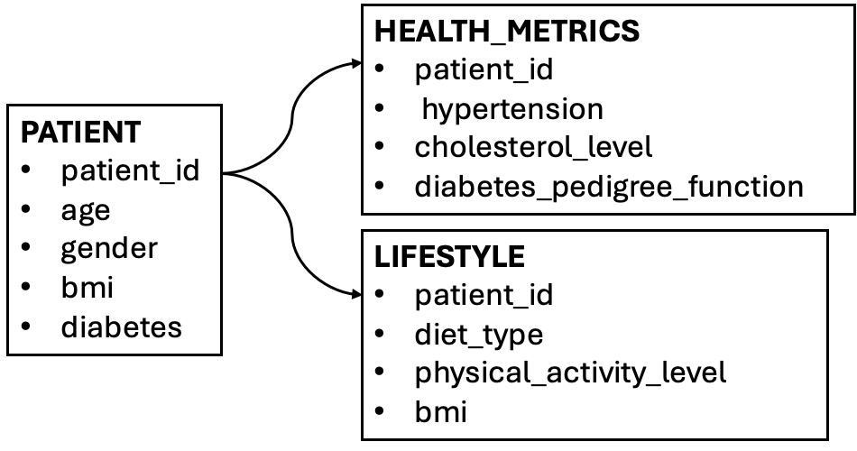
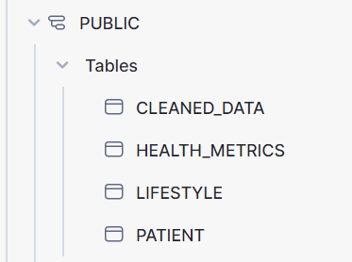
SQL Database Scheme
Notes:
Categorical Variables
The statistical analysis for the association of diabetes with each of the categorical variables in the dataset reveals, that with a 1% significance level, there exists enough evidence to reject the null hypothesis in the case of family history of diabetes, physical activity, stress level, and alcohol consumption. This conclusion supports the initial evidence gathered in the visual bivariate analysis. In addition, it is a reasonable indication in the context of diabetes:
- Family history: Type 2 diabetes can be caused by genetic factors
- Physical activity: regular excercise can result in sustained improvements in insulin sensitivity and glucose disposal
- Stress level: According to the National Library of Medicine, stress has a significant impact on metabolic function; Type 2 diabetes may be initiated by psychological and physical stress
Alcohol Consumption: alcohol can increase the risk of developing Type 2 diabetes, and also interfere with the effect of certain diabetes medicines. Therefore, further study is needed into the elevated alcohol consumption levels registered for diabetic patients.
Numerical Variables
The statistical analysis for the mean of numerical variables acros diabetes diagnoses reveals, that with a 1% significance level, there exsits enough statistical evidence to reject the null hypothesis in the case of BMI and weight. This conclusion supports the intial evidence gathered in the visual bivariate analysis. In addition, it is a reasonable indication in the context of diabetes, where accumulation of an excessive ammount of body fat can lead the the diagnosis of Type 2 diabetes.

Slide 12
SQL Database Scheme
PATIENT
Gender
Bmi
Diabetes
Age
Patient_id
LIFESTYLE
HEALTH_METRICS
Diabetes_pedigree_
function
Stress_level
Hypertension
Sleep_duration
Alcohol_consumption
Diet_type
Physical_activity_level
Notes:
This slide explains how we converted our cleaned data into a structured SQL database using SNOWFLAKE, which played a key role in our analysis. Using the cleaned data as explained in the previous slide. We created a detailed SQL database schema, organizing the data into three main tables: Patient (primary key), Health Metrics, and Lifestyle.
This structured setup allowed us to store and retrieve data efficiently, forming the foundation for our Power BI dashboard. The dashboard used metrics from these tables to create insightful charts and visualizations, helping us understand the links between health, lifestyle factors, and diabetes. This organized approach improved our data handling and made our analysis clearer and more focused.

Slide 13

Dashboard

Slide 14
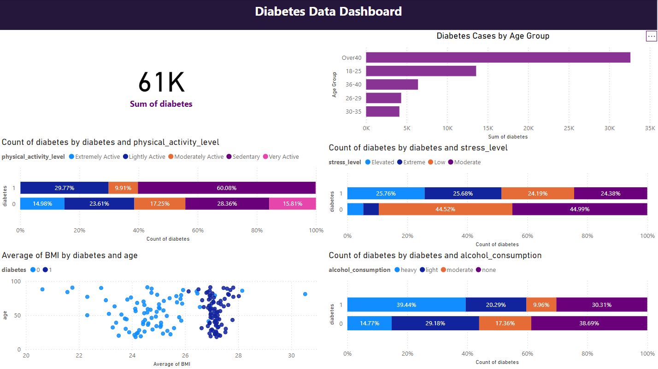
Notes:
Our analysis, based on SQL queries visualisations created in powerBI. A quick reminder: in the dataset, 0 represents the non-diabetic group, and 1 represents the diabetic group.
We have selected five notable visualisations that provide key insights. Looking at the demographic and health data:
Diabetes cases are more prevalent among individuals aged over 40 and those in the 18–25 age group.
The data does not show a strictly positive linear correlation, but certain age groups clearly warrant targeting for diabetes prevention plans.
Another significant insight is that a higher BMI increases the likelihood of developing diabetes, as represented by the blue dots on this chart.
From the lifestyle data, we observed correlations between diabetes and various factors:
Physical activity: Non-diabetic groups tend to be more sedentary, while diabetic groups participate in higher levels of physical activity.
Stress levels: Diabetic groups are strongly associated with higher stress.
Alcohol consumption: Diabetic groups consume more alcohol compared to non-diabetic groups.
(This page summarises our findings. Skip)

Slide 15
Data Insights
Diabetes cases are more prevalent in individuals over 40 and in the 18-25 age group
A higher BMI increases the likelihood of developing diabetes
Non-diabetic groups are highly sedentary, while diabetic groups engage in more physical activity
Diabetic groups are strongly associated with higher stress levels
Diabetic groups consume more alcohol compared to non-diabetic groups
Notes:
rvoid bias in the analysis

Slide 16
Recommendations
Target High-Risk Groups: Educate people over 40 and 18-25 on managing diabetes risks
Promote Exercise: Encourage regular physical activity to improve insulin sensitivity
Reduce Stress: Provide stress management resources like meditation or counselling
Limit Alcohol: Raise awareness of alcohol's role in diabetes risk and medication interference
(Support Families: Offer guidance to those with a family history of diabetes)
Health Screenings: Combine BMI, stress, and alcohol screenings with prevention tips
Other things to consider:
The dataset contains a low percentage of records for non-diabetic patients, which can limit the robustness of comparative analyses
The dataset does not distinguish between Type 1 and Type 2 diabetes which have different characteristics, causes, and treatments
Expert input from the field of medicine is required to further review, validate, and interpret the results presented
Notes:
Based on these insights, we suggest:
Educating high-risk groups, such as those aged 18–25 and over 40, on managing diabetes risks.
Encouraging actions such as:
Promoting regular exercise.
Reducing stress levels.
Limiting alcohol consumption.
Additionally, while not visualised here, we identified that a family history of diabetes is also linked to higher risk. Offering guidance to individuals with a family history of diabetes could further support prevention efforts.
Future Considerations
Before implementing diabetes support plans—whether for companies, medicine, or individual use—consider these limitations:
Dataset imbalance: The data includes a low percentage of records for non-diabetic patients, which may reduce the robustness of comparative analyses.
Expert validation: Input from medical professionals is essential to review, validate, and interpret the findings accurately.

Slide 17
Recommendations
Target High-Risk Groups: Educate people over 40 and 18-25 on managing diabetes risks
Promote Exercise: Encourage regular physical activity to improve insulin sensitivity
Reduce Stress: Provide stress management resources like meditation or counselling
Limit Alcohol: Raise awareness of alcohol's role in diabetes risk and medication interference
(Support Families: Offer guidance to those with a family history of diabetes)
Health Screenings: Combine BMI, stress, and alcohol screenings with prevention tips
Other things to consider:
The dataset contains a low percentage of records for non-diabetic patients, which can limit the robustness of comparative analyses
The dataset does not distinguish between Type 1 and Type 2 diabetes which have different characteristics, causes, and treatments
Expert input from the field of medicine is required to further review, validate, and interpret the results presented
Notes:
Outliers & Inconsistencies examples
BMI: upper and lower-bound outliers > capped lower level at 12 (minimum BMI level before life threatening), capped lower lever using IQR (Q3 + 1.5 * IQR)
Weight: lower-bound outliers (unreasonable weight for a human adult) > dropped values below 75 lb
Sleep: the min hours of sleep registered was 0 (unreasonable) > data was capped at a min on 2 hours
Missing Values
Where appropriate and required missing values for explanatory variables were imputed using the corresponding distribution
Missing values for the target variable where not imputed or altered to avoid bias in the analysis

Slide 18
Thank you

